Slide 1
Applying Analytics to Big Data in Operations Management
G
MODULE

Slide 2
Introduction to Big Data
Big Data
The huge amount of production, consumer, and social media data collected in digital form
Business Analytics
Uses tools and techniques to convert data into summary information and business insights for decision making
Data Challenges
Gather the right data
Apply the best tools

Slide 3
Introduction to Big Data
Data can be generated from
web sites
credit cards
point-of-sale records
social media
Operational data
Part or serial number
Workstation
Quality tests
Maintenance
Logistical moves
Assembly line
Time
Basically everywhere

Slide 4
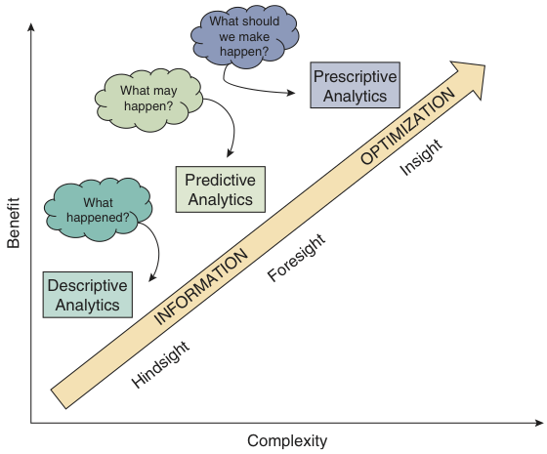
Types of Analytics
Figure G.1

Slide 5
Data Management – Descriptive
Completeness: the degree to which all required data are present
Consistency: the degree to which data are equivalent across systems
Accuracy: The degree of conformity of a measure to a standard value

Slide 6
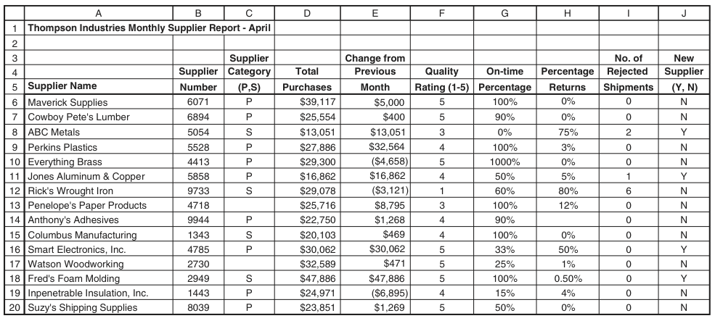
Data Management
Figure G.2

Slide 7
Examples for Cleaning Data
Check the following four items:
Any blank entries need to be identified and filled.
The percentages in columns must be between 0% and 100%.
The value in column E for a supplier cannot exceed the value in column D for that supplier.
The value in column F for a supplier should not be 5 if the value in column H exceeds 10%.
Conditional Formatting
What are the exceptions to profit over time?
What was the maximum profit? The minimum?
Who sold more than $50,000 this month?
Which products had demand decrease by more than 12% this month?
Which products had the most rejected shipments?

Slide 8
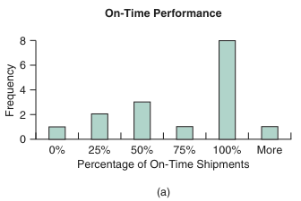
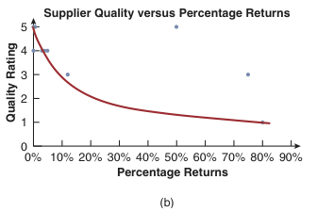
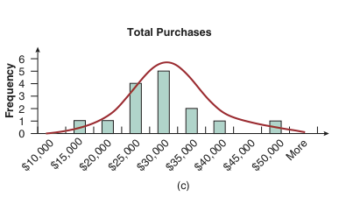
Graphical Techniques for Cleaning Data
Figure G.3

Slide 9
Excel Examples for Cleaning Data
Example G.1
Select A6:J20; Rule type: Format only cells that contain, select Blanks; Color purple.
Select G6:H20; Rule type: Format only cells that contain, select Cell value, then not between, then 0 and 1; Color light green.
Select E6:E20; Rule type: Formula, enter =E6>D6; Color maroon.
Select F6:F20; Rule type: Formula, enter =AND(F6=5,H6>0.1); Color dark green.

Slide 10
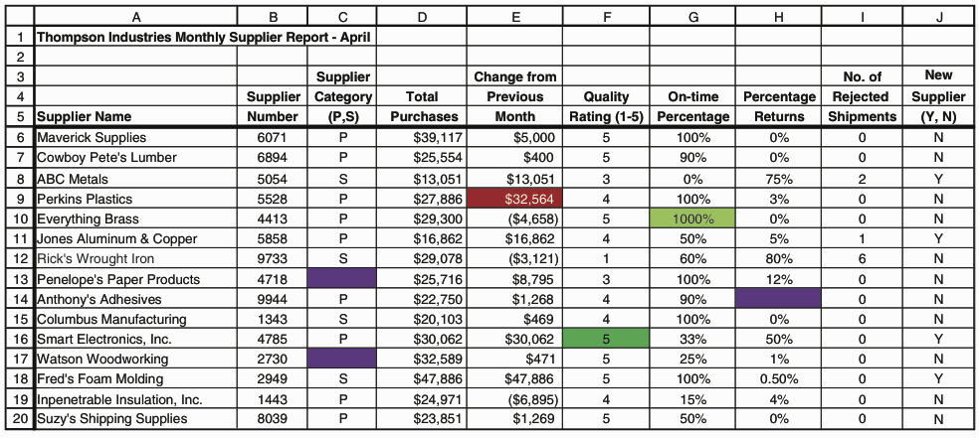
Excel Results for Cleaning Data
Figure G.4

Slide 11
Excel Technique for Cleaning Data
In a PivotTable
Filters: filters the whole dataset
Rows: all entries with the same value for that field will be summarized in one row
Columns: all entries with the same value for that field will be summarized in one column
Values: contain the numeric fields that the user wishes to summarize

Slide 12
Data Visualization – Descriptive
Data
Is a snapshot in time
Collection of “things”
Numbers, categories, colors, etc…
Foundation of every visualization
Visualization
Helps show what otherwise would not be obvious
Nonlinear, iterative process to develop
Tells a story
Creative process
Changes for each dataset

Slide 13

Main Point

Slide 14
Overview – The Questions
What data do you have?
This may take some exploring
What story are you trying to tell?
Can be semi political in nature
Who are you telling the story to?
Consider who sponsored your work

Slide 15
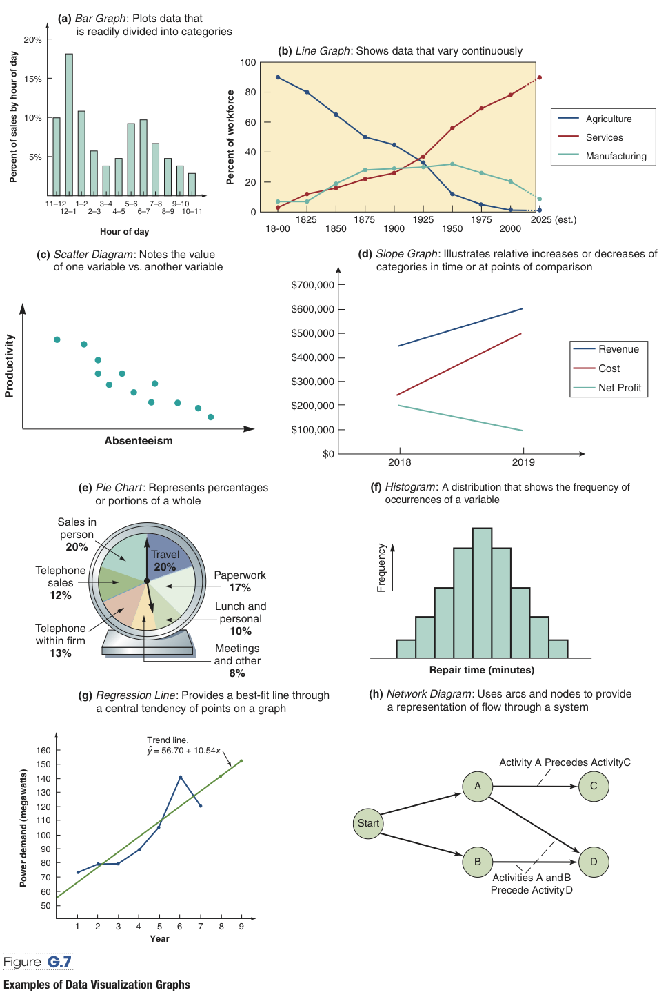
Basic Data Visualization
Figure G.7

Slide 16
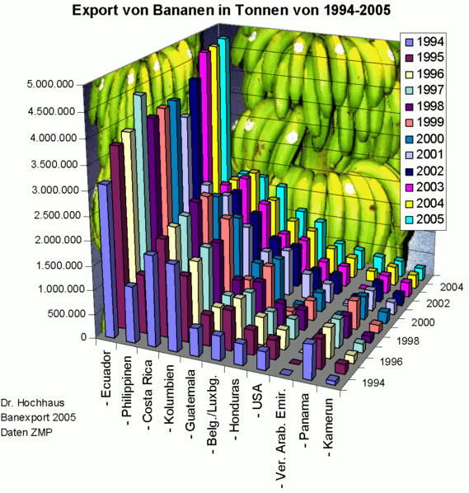
Good or Bad…Why?
{Export of Bananas in tons from 1994-2005}
https://excelcharts.com/tag/bad-examples/

Slide 17
Data Visualization Process
Know your data and what it means
Context and reliability
Explore data
Develop initial visualizations
Look for
Patterns, trends, relationships, anything that doesn’t look right
Errors and typos
The unexpected
Try not to let what you want to see impact what is seen
Communicate to audience
Know your audience
Match visualizations to audience
Same data will be presented differently to different groups
For the person developing a visualization…
The process of developing a visualization can lead to more understanding of the data than the final product

Slide 18
Visualization as a Medium
Do not approach visualization as an exercise to show off technical computer skills
Excel default graphs are not the only options
Represents data in an abstract way similar to words
Think of visualizations as visual stories
Rules are governed by human perception
Must distinguish between rules and suggestions
Advice might be guidance not a strict rule
Speed of comprehension or simplicity of visualization not sole judge of quality

Slide 19
Data Visualization
Graphing Tips
Graphs should be self-explanatory
Ensure that multiple datasets on the same graph each have a key or legend
Do not overwhelm the viewer with too much data in a figure
Avoid 3-dimensional graphics
Dashboards present an overview of important metrics

Slide 20
Common Tool – Tableau
What is Tableau?
More sophisticated than Excel
More of a graphical interface (DOS vs Windows operating system)
Used by United Nations for their visualizations
https://www.tableau.com/account/united-nations
Go to Tableau’s Visualization of the Day for ideas
https://public.tableau.com/en-us/gallery/?tab=viz-of-the-day&type=viz-of-the-day
Try for free for 15 days
https://www.tableau.com/products/desktop/download
Free training videos
Used extensively for this course
https://www.tableau.com/learn/training/20201

Slide 21
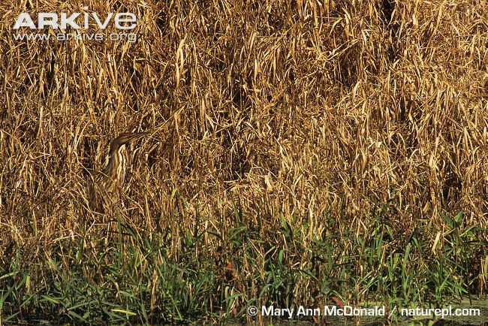
Let the Data Talk
Remember…It is not about what you want to see…it is about the story that the data tells.
“The greatest value of a picture is when it forces us to notice what we never expected to see.”
John W. Tukey, Exploratory Data Analysis (1977)

Slide 22
Predictive & Prescriptive Analytics
Tools covered in this text include
Forecasting/time series analysis
Correlation and regression analysis
Decision tables and trees
Linear programming
Queuing theory
Learning curves
Simulation
Data mining
Explore very large data sets looking for patterns or relationships
Text analysis
Sentiment analysis/opinion mining
Pattern analytics

Slide 23
Predictive and Prescriptive Analytics
Mapping and tracking
Sensors or video
Part or product movement
Customer movements
Cohort analysis
Behavior of groups over time
Cluster analysis
Identifies and organizes data into groups with similar attributes

Slide 24
Neural Networks & Machine Learning
Computer systems take large volumes of data and potential variables to form groupings of variables to identify complex associations
Machine learning provides a vehicle to sift through vast amounts of data to provide insight
Slides based on
Charikar, Ma, Re, Stanford CS229: Machine Learning,
Eaton, UPenn, CIS 519, Introduction to Machine Learning
Balcan, CMU, CS 10-401, Machine Learning
Russell, UC Berkeley CS 194: Introduction to Machine Learning
Silver, UCL, COMPM050: Reinforcement Learning
Spiess, Stanford GSB, Applied Machine Learning: intro

Slide 25
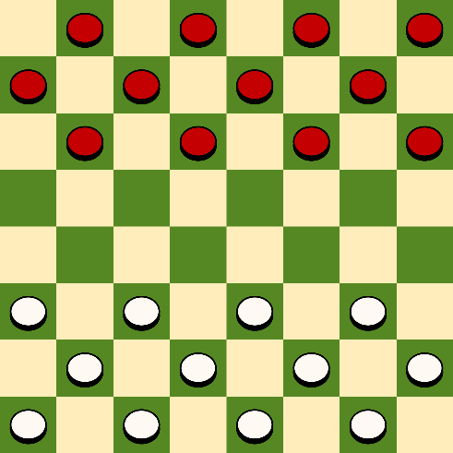
What is ML?
A computer program is said to learn from experience E with respect to some class of tasks T and performance measure P, if its performance at tasks in T, as measured by P, improves with experience E.
ML is the study of computer algorithms that can improve their performance at some task through experience
--- Tom Mitchell (1998)
Example
Task: play games; Experience: games played by the program; Performance measure: winning rate

Slide 26

Examples of Supervised Learning
Face Detection and Recognition
Automatic Speech Recognition
Figure credit: Facial recognition: It’s time for action, Microsoft

Slide 27
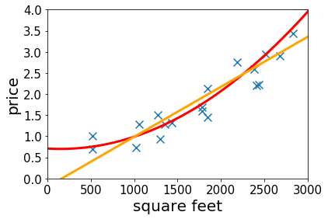


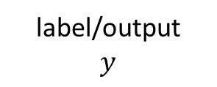

Supervised Learning (cont’d)
If a residence has $400$ square feet, predict its price based on historical data
Size (square feet) | Price
100 | 100K
420 | 200K
250 | 150K
230 | 140K
400 | ?
$$y=f(x)$$
size $→$ price
features/input
$$x$$
label/output
$$y$$

Slide 28

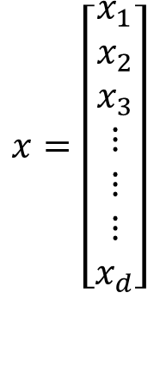
Supervised Learning (cont’d)
What if we know more?
--- living size
--- lot size
--- # floors
--- condition
--- zip code
$$⋮$$
$$x=\left[\begin{aligned}x_{1} \\ x_{2} \\ x_{3} \\ ⋮ \\ ⋮ \\ ⋮ \\ x_{d}\end{aligned}\right]$$
y=f(x₁, x₂, x₃,…x_{d})
y--- price
Size | Lot Size | #floors | Condition | Zip Code | Price
100 | 100 | 1 | 0 Yrs | 06269 | 100K
420 | 420 | 2 | 10 Yrs | 06269 | 200K
250 | 250 | 1 | 5 Yrs | 06066 | 150K
230 | 230 | 3 | 20Yrs | 06067 | 140K
400 | 400 | 2 | 15Yrs | 06066 | ?

Slide 29
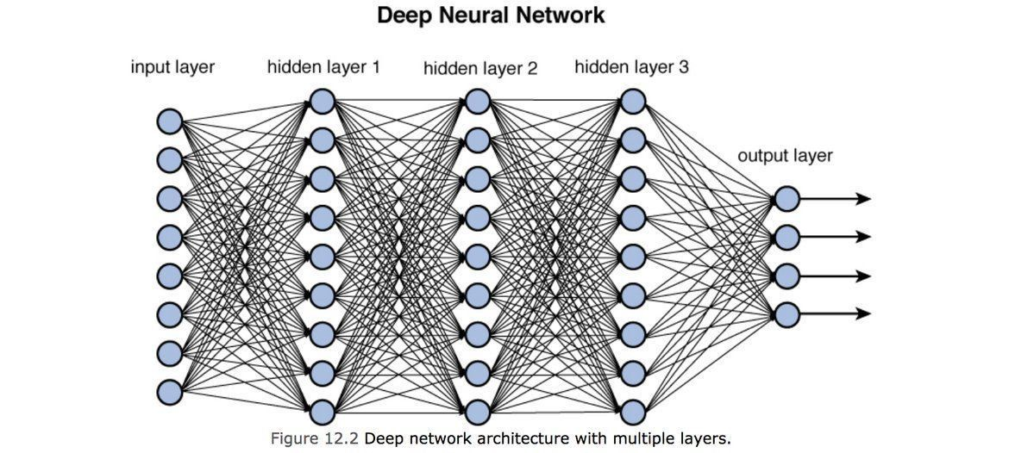
Artificial Neural Networks
One of the most widely-used models in ML field
Behind the buzzword “Deep” Learning

Slide 30
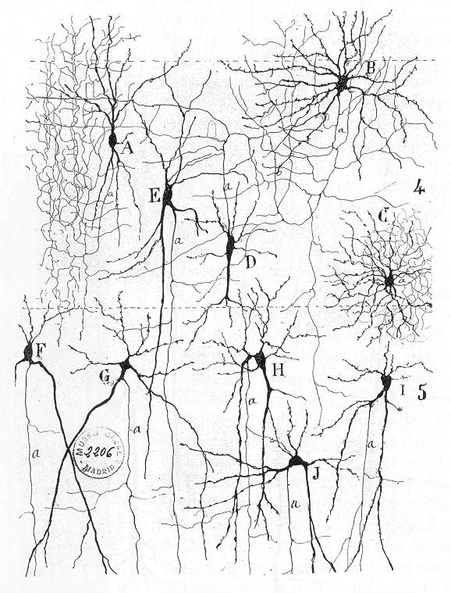
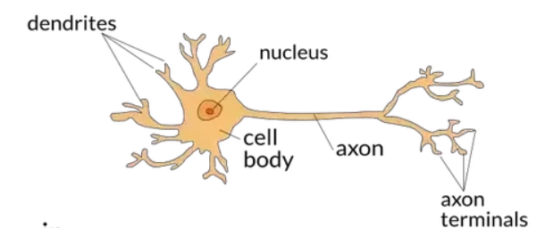
Biological Neural Networks
Brain: very complex network/web of interconnected neurons
Consists of 10¹¹ neurons of >20 types,
Signals are noisy electrical potentials
Highly connected to others, and performs computations by combining signals from other neurons
Outputs of these computations may be transmitted to one or more other neurons.
Figure credit: Wikipedia Neural Circuit

Slide 31
Artificial Neural Networks
Artificial Neural Networks built out of a densely interconnected set of simple units
Oversimplification of real neurons, but its purpose is to develop understanding of what networks of simple units can do
Examples of activation functions
Figure credit: The differences between Artificial and Biological Neural Networks, Towards Data Science

Slide 32
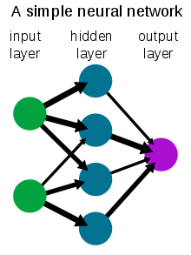
Artificial Neural Networks (cont’d)
Artificial Neural Networks built out of a densely interconnected set of simple units
Figure credit: Wikipedia Neural Networks; Toward Data Science: training deep neural networks

